Slide 1
Why SQL is called RDB
JOIN

Slide 2
Join
SQL is called relational database because it has the ability to establish links or relationships between information by joining tables.
A join is a select statement that is used to combine two or multiples tables together based on their keys values.
We have 4 types of joins:

Slide 3

Type of Joins
Inner Join
The inner join produces a dataset that includes only matching rows from the both tables.

Slide 4
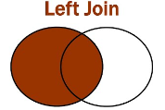
Type of Joins
Left Join
The left join returns all rows from the left table and the matching rows from the right table.

Slide 5
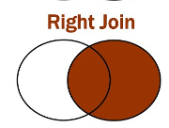
Type of Joins
RIGHT Join
The right join returns all rows from the right table and the matching rows from the left table.

Slide 6
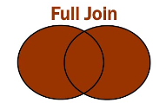
Type of Joins
Full Join
The full join returns all rows from the both tables (right and left).

Slide 7
Illustration
The schema name is hotel. it has 3 tables:
booking (Booking_Id, Customer_Id, Room_Id, Quantity)
customer (Customer_Id, name, email, Room_Id)
room category (Room_Id, Room_type, Room_size, City)
The stakeholder would like to know: which city has the highest booking?
Here is the query:

Slide 8
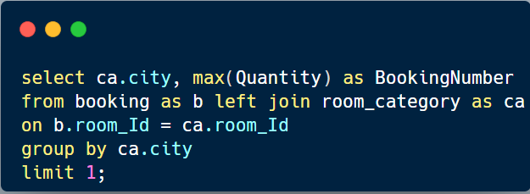

Which city has the highest booking?

Slide 9
Thanks for reading!
Don’t forget to comment and add more insights.

